Slide 1
Data Collection and Surveillance
Security, Privacy, and Consumer Protection Nick Feamster University of Chicago

Slide 2
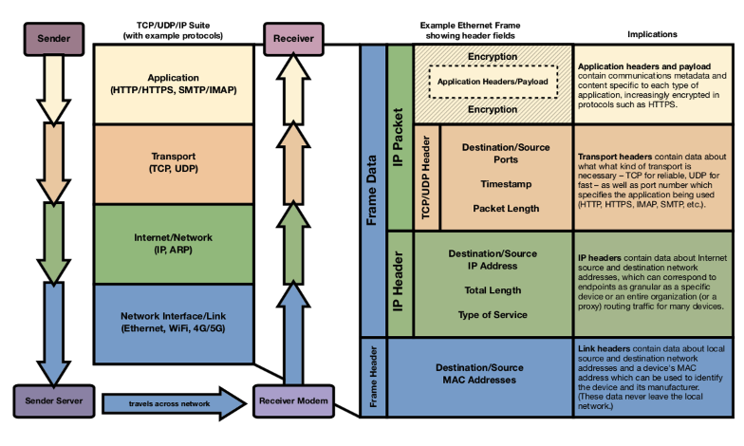

Slide 3
Metadata

Slide 4

“You have my telephone number,
connecting with your telephone number.
There are no names… in that database.”
-President Obama

Slide 5
“All it is, is the number pairs,
when those calls took place,
how long they took place.
So that database is sitting there.”
-President Obama

Slide 6
1. Metadata and Federal Law
2. NSA’s Domestic Metadata Programs
3. Study Design
4. Graph Structure
5. Re-Identification
6. Inferences

Slide 7
Possible Definitions
{
data about data
colloquial
the “fact of” a communication
“envelope” information
-
routine records
business
-
technical standards
engineering
{
non-content
dialing, routing, addressing, and signaling
legal
specific categories of information
information that is knowingly divulged

Slide 8
For real-time person-to-person communications,
these definitions point in the same direction.

Slide 9
Phone
Text Messaging
Parties
Email
Direction
iMessage
Time
Google Hangouts
Skype
Length
…

Slide 10
John Smith
1060 W. Addison St.
Chicago, IL 60613
Number | Direction | Time | Duration
(415) 863-2800 | Outgoing | 9/4/14 11:49am | 2m 27s
. . .
Chinese
Takeout
Lunch

Slide 11
These definitions can result in multiple “layers”
of metadata for a single communication.

Slide 12





Login
EmailCo
■ Session metadata
■ Message metadata

Slide 13
Unfortunately, sometimes these definitions
point in opposite directions.

Slide 14
Challenging Fact Patterns
a. Communications that aren’t person-to-person.
Example: web browsing.

Slide 15
http://searchengine.com/search?query=Stanford+map
Metadata
?
Content

Slide 16
Challenging Fact Patterns
a. Communications that aren’t person-to-person.
Example: web browsing.
b. Stored communications.
Example: webmail.
c. Location information.
Explicit Example: cell site location information.
Implicit Examples: IP addresses, trunk identifiers.

Slide 17
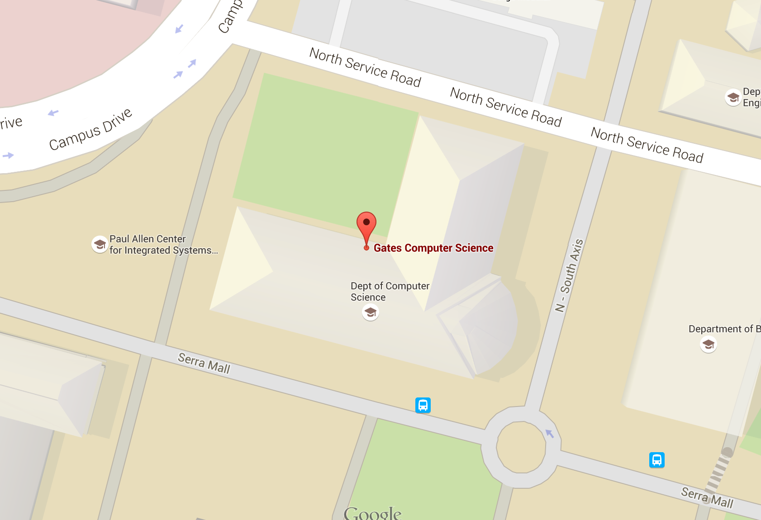
171.64.78.██

Slide 18
If a court concludes that certain information is metadata for constitutional and statutory purposes…

Slide 19
Emphasis on domestic.

Slide 20
Email
(2001-2011, FISC approved in 2004)

Slide 21


Slide 22
Phone
(2001-2015, FISC approved in 2006)

Slide 23
FISA Business Record Order
Telco
Bulk Telephone Metadata

Slide 24



USA FREEDOM
Phone
Metadata
18 Months
FOREIGN INTELLIGENCE
Raw Data
Analysis
2 Hops
Distribution
COUNTER-TERRORISM
Analyst
Targeting
RAS
Corporate Store
Station Table

Slide 25
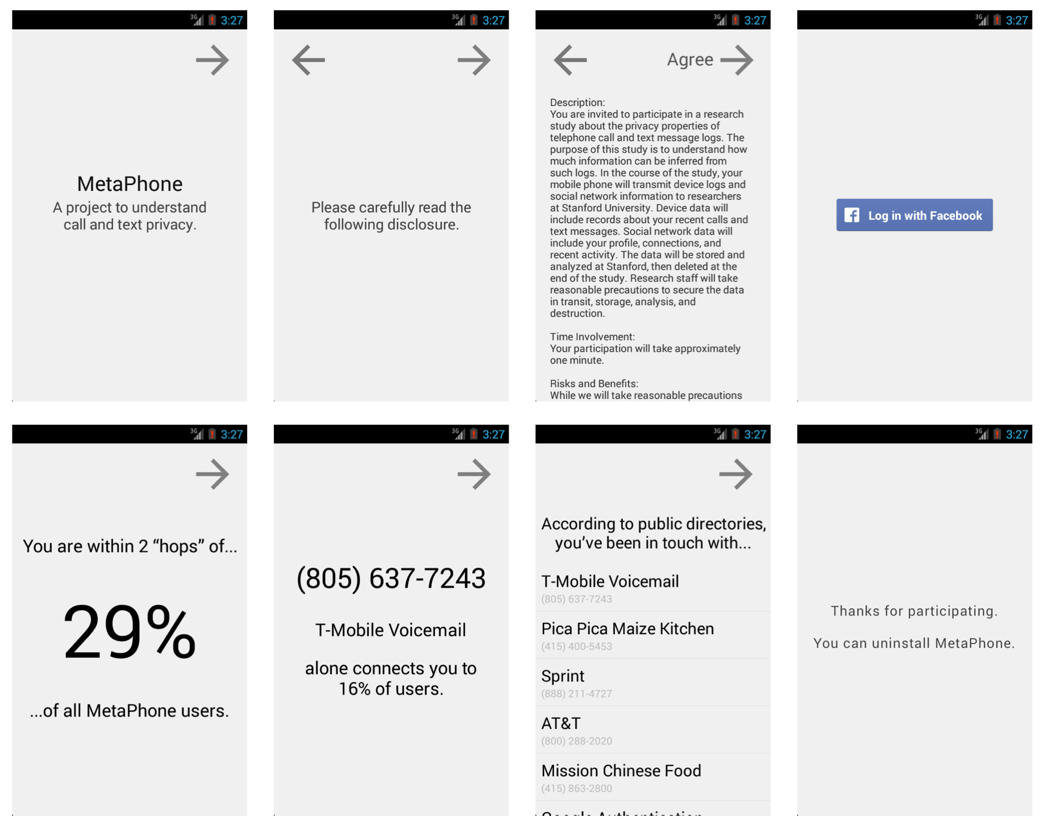

Slide 26
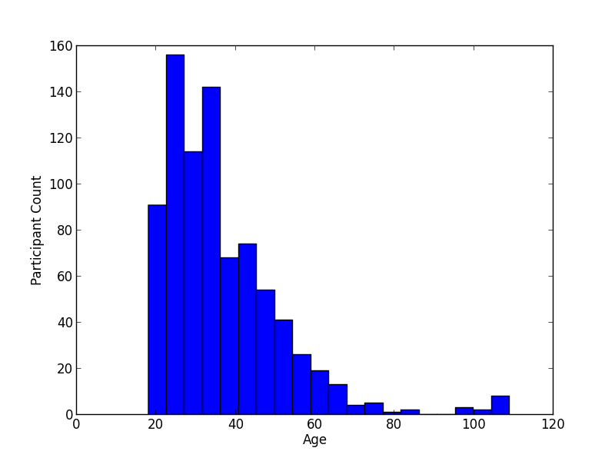
Age

Slide 27
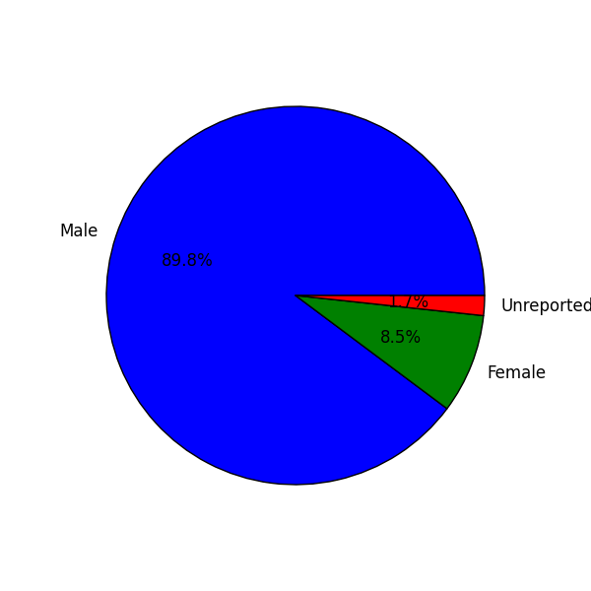
Gender

Slide 28
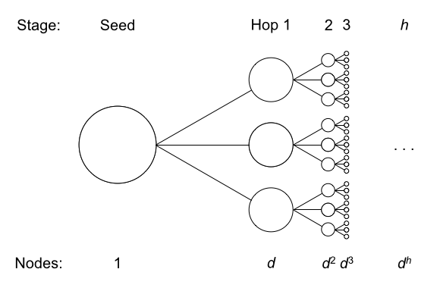

Slide 29
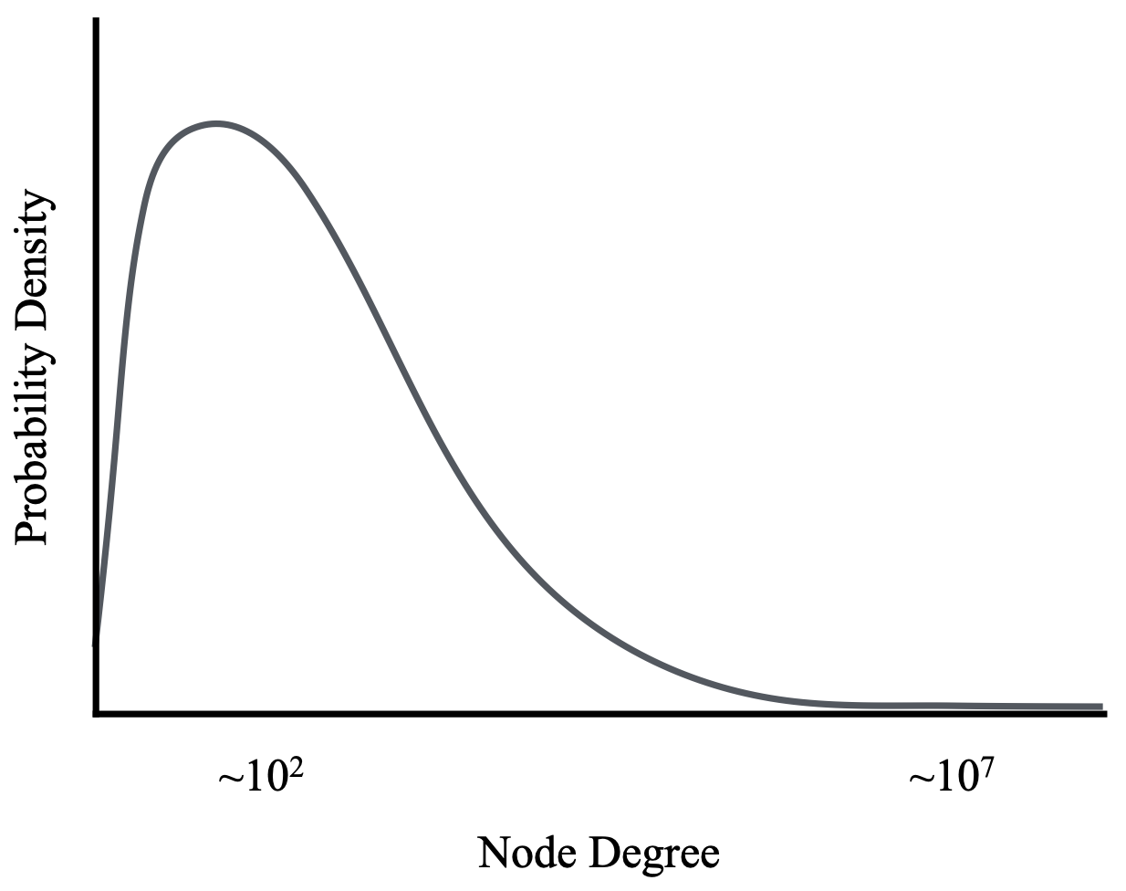
Approximate degree distribution over one year.

Slide 30
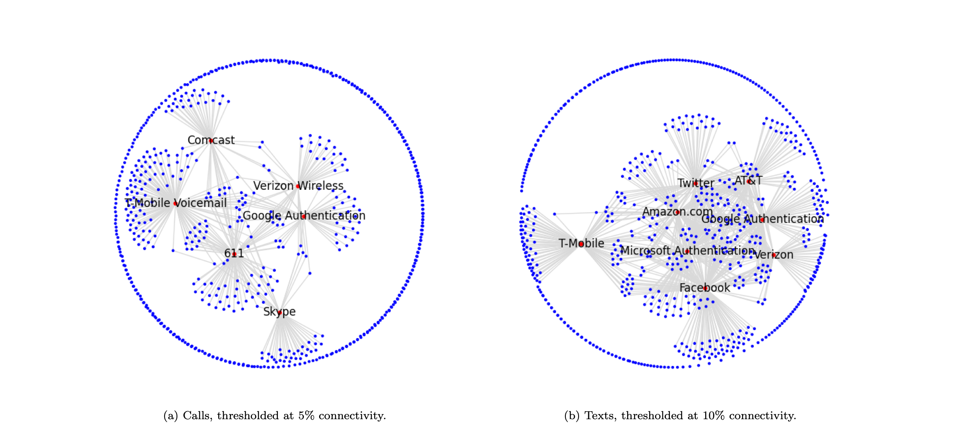

Slide 31
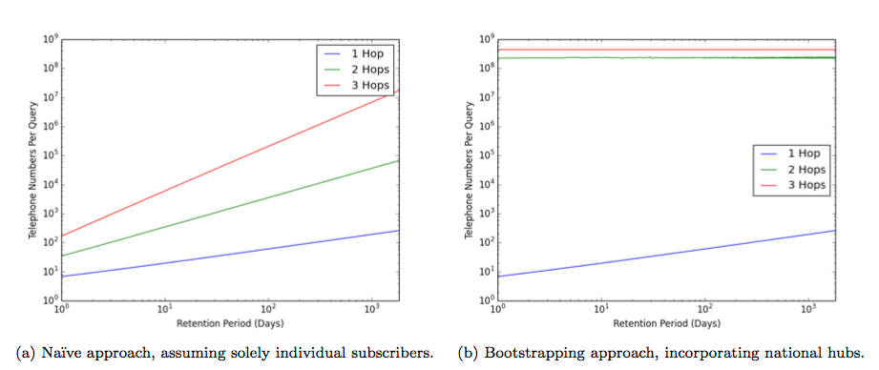
USA FREEDOM + filtering out popular numbers
≈
25,000 phone subscribers per query

Slide 32
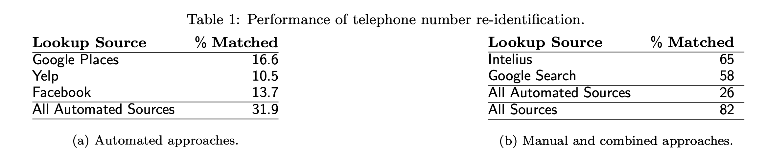
Re-Identification

Slide 33
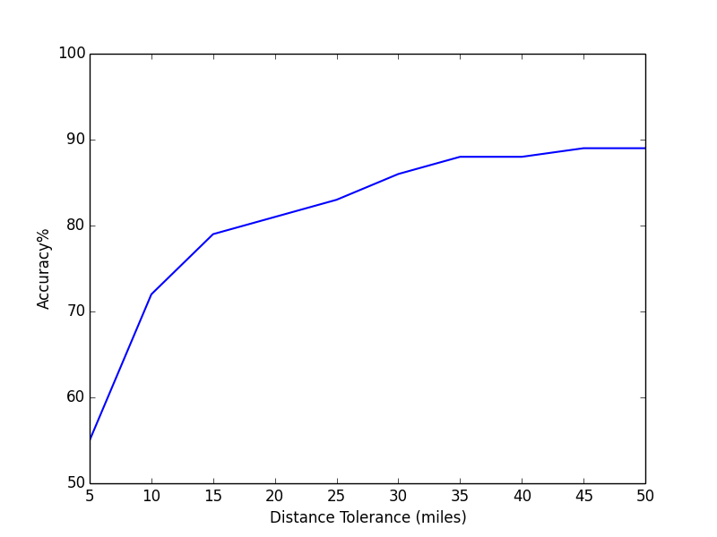
Home Location Inference
Methodology: re-identify businesses, cluster their locations

Slide 34
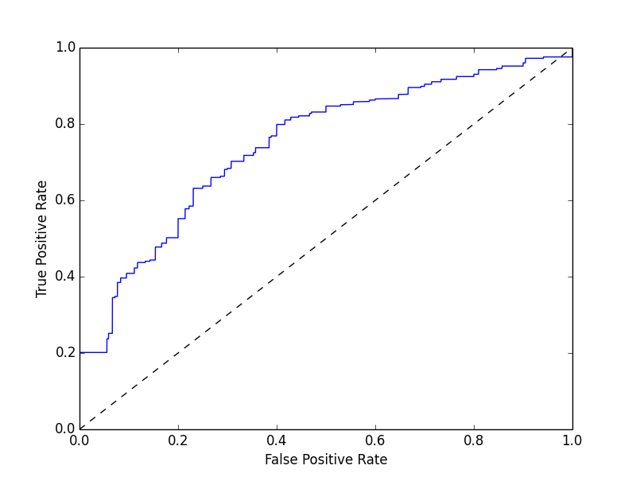
Relationship Inference
Methodology: generate features from metadata, train an SVM

Slide 35
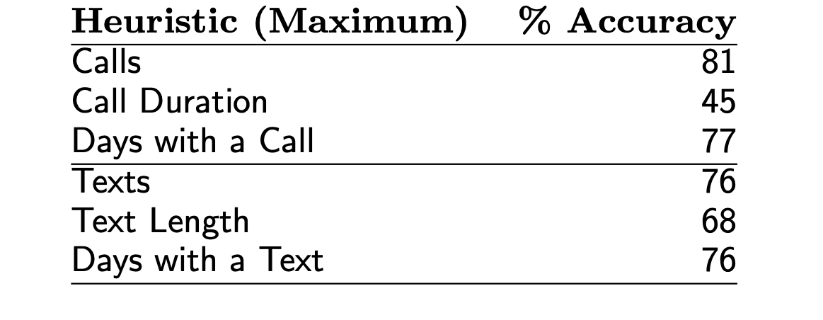
Relationship Inference
Methodology: comparison to Facebook data

Slide 36
Religion Inference
≈ 3/4 accuracy
(naïve heuristic on a small sample)
Methodology: comparison to Facebook data

Slide 37
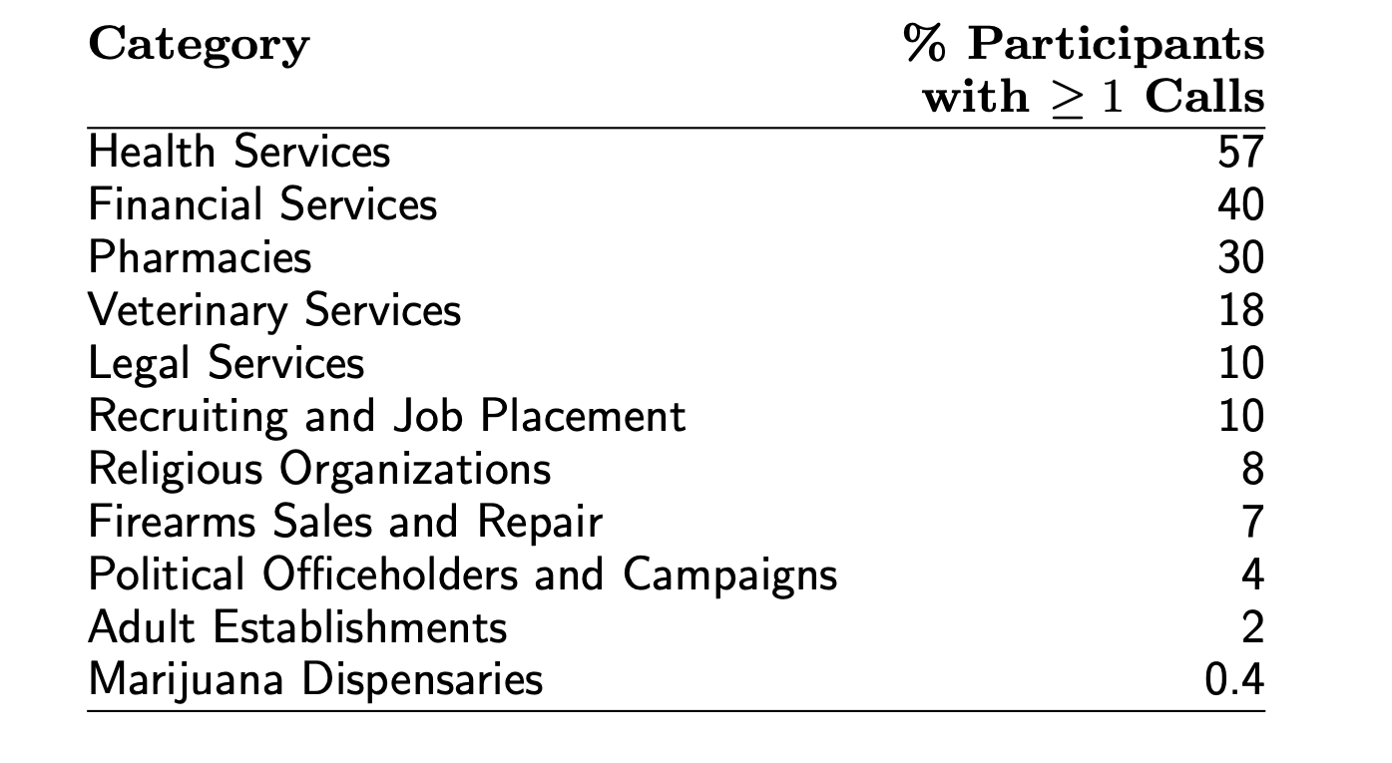
Sensitive Trait Inference
Methodology: automated number re-identification

Slide 38
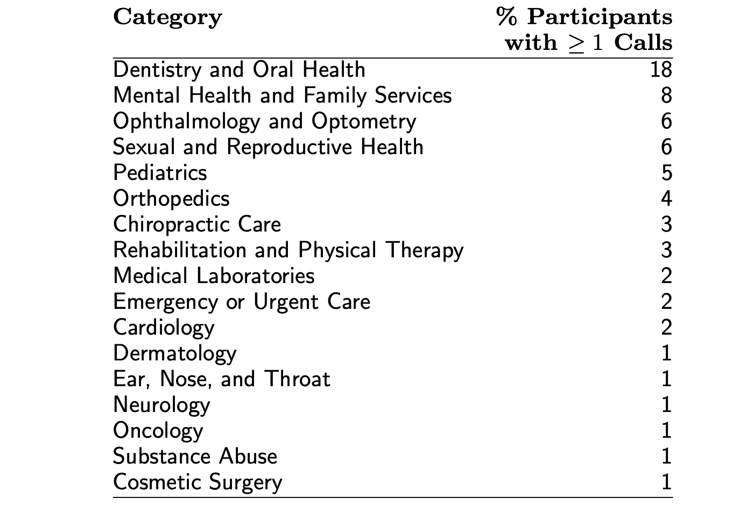
Sensitive Trait Inference
Methodology: automated number re-identification

Slide 39
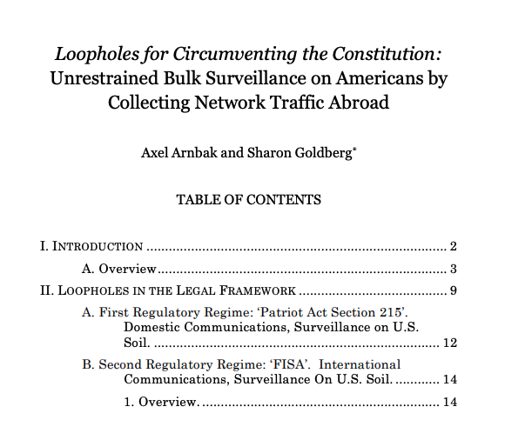
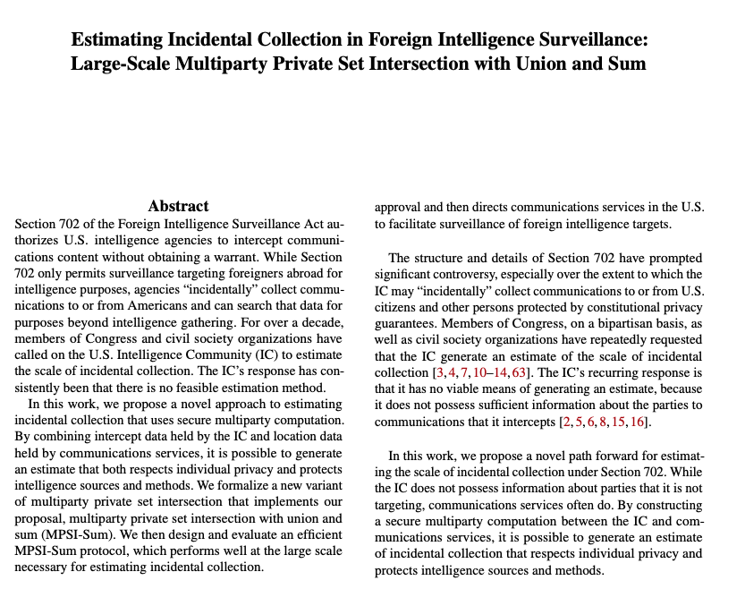
What’s New/Ongoing: FISA and Incidental Collection

Slide 40
DNS, Surveillance, and Privacy

Slide 41
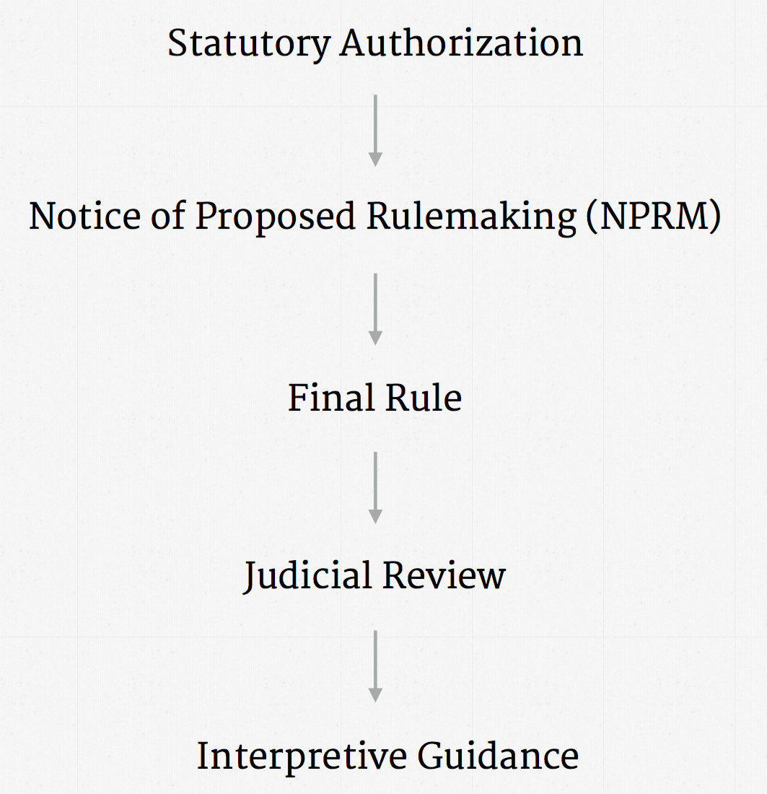
FCC Rulemaking Process
Credit: Jonathan Mayer

Slide 42
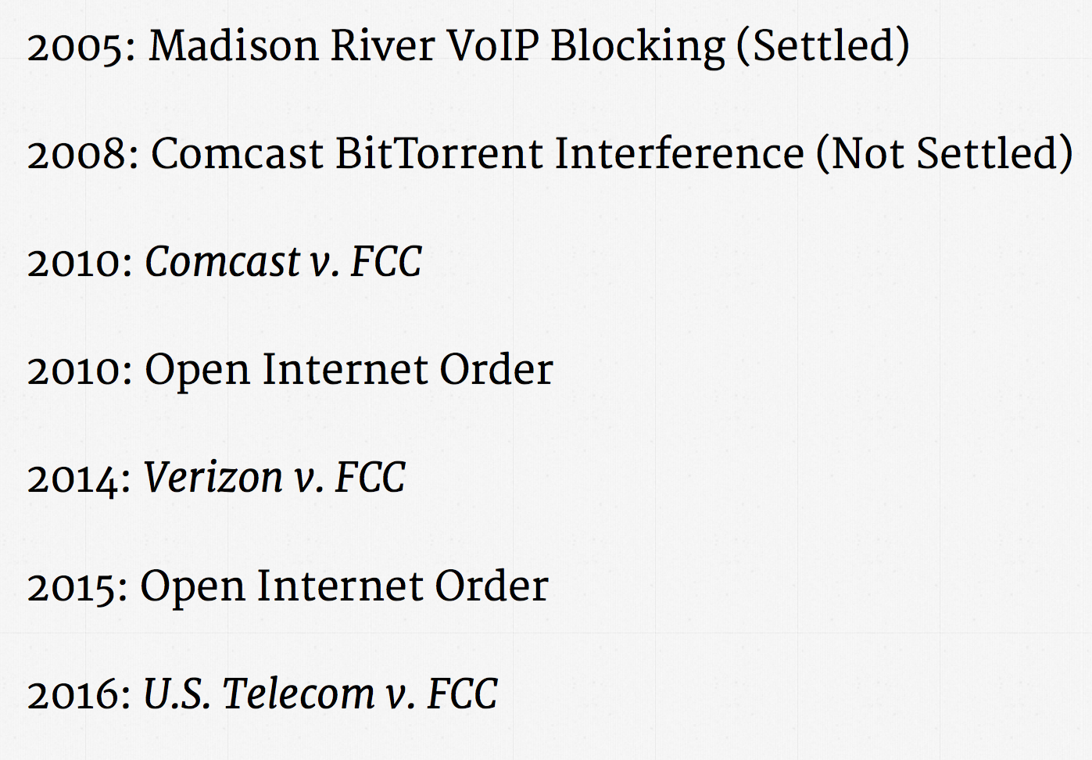
History of the Open Internet Order
Credit: Jonathan Mayer

Slide 43
Open Internet Order: Reclassification of ISPs Under Title II
Bright Line Rules
Transparency
No blocking
No throttling
No paid prioritization
No unreasonable interference or disadvantage
… various exceptions for “reasonable network management” practices

Slide 44
A Less-Discussed Aspect of OIO: Privacy Rules
Reclassification of ISPs under Title II makes them subject to the Telecommunications Act
Section 222: Privacy of Customer Information
“Every telecommunications carrier has a duty to protect the confidentiality of proprietary information of, and relating to, other telecommunication carriers, equipment manufacturers, and customers, including telecommunication carriers reselling telecommunications services provided by a telecommunications carrier.”
Confidentiality of “Customer Proprietary Network Information”
Exceptions:
Billing, protection of property rights, public safety, delivery of emergency services, …
“…to protect the rights or property of the carrier, or to protect users of those services and other carriers from fraudulent, abusive, or unlawful use of, or subscription to, such services;”

Slide 45
April 2016: FCC Notice of Proposed Rulemaking
Several aspects
Protection of content
Protection of CPNI (e.g., SSN, address)
Data security and breach notification
Defining scope
Who is subject to the rule? (“BIAS” Providers)
What constitutes CPNI? (e.g., IP addresses?)

Slide 46
Scope: Who’s In, Who’s Out?
In: Broadband Internet Access Service Providers (“BIAS”)
Basically, your access ISP
Comcast, AT&T, Verizon, …
Out: Other service providers who are not under Title II
Search (Google), Social networking (Facebook), Online services (Netflix)
FTC has defined a different set of rules for these parties

Slide 47
Side Discussion: Parity
ISPs were arguing that privacy protections would place them at an unfair advantage
Content providers are under a different set of privacy rules (FTC)
Many commenters (Ohm et al.) suggested that the FCC rules might follow the FTC model

Slide 48
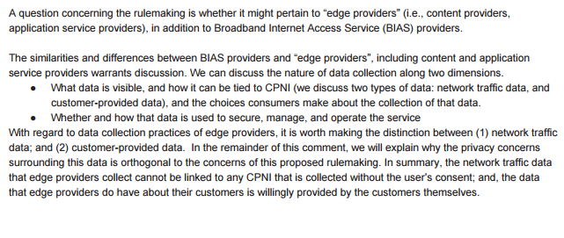
Parity: My Comment
ISPs and content providers are apples and oranges
Type of data collected
How the data is used (advertising vs. operation)
Customer switching costs

Slide 49
Going Back in Time…
February 2016: Peter Swire publishes whitepaper (funded by Broadband for America) arguing that ISPs don’t really see that much about customers.
March 2016: I reply with a letter directly to the FCC chairman.

Slide 50
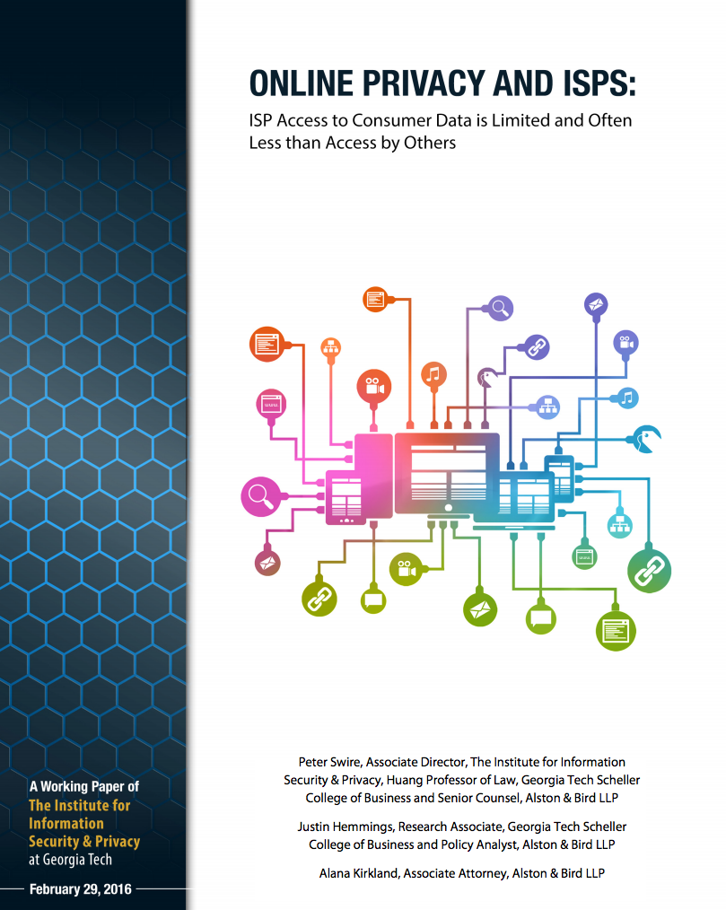

Slide 51
Main Points in Report (February 2016)
Users are mobile: No one ISP might have a comprehensive view of traffic from a user.
End-to-end encryption: HTTPS is becoming more pervasive, so ISPs can’t see web content.
VPN usage: Users are gaining increasing access to VPNs, which also encrypt traffic

Slide 52
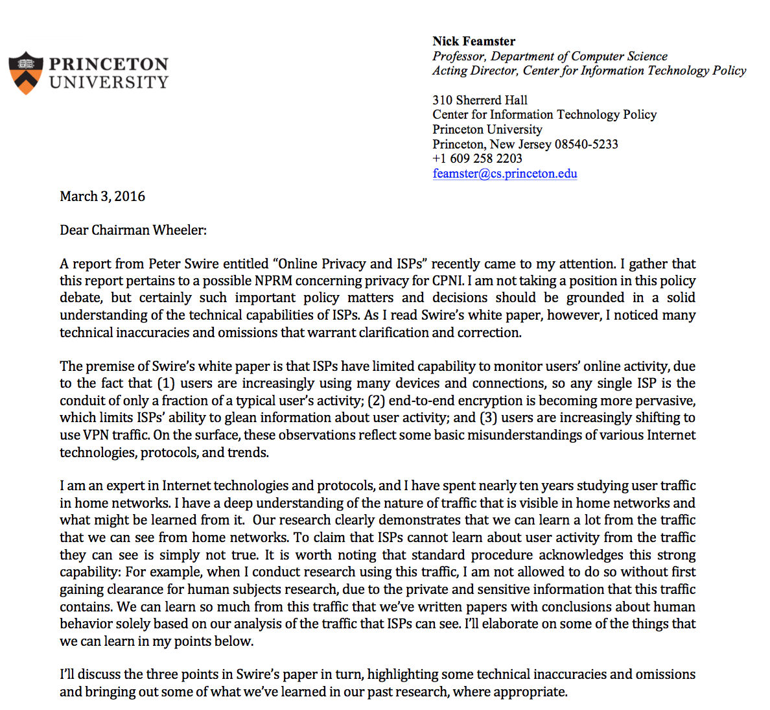

Slide 53
User Mobility
Any single ISP has a home gateway, which serves as a convenient vantage point for capture.
ISPs are increasingly deploying “shared WiFi” services (e.g., Xfinity Wifi).
Note: This does not mean that ISPs are capturing data from the gateways for these purposes. My point was mainly to say that the mobility argument is disingenuous.

Slide 54
End-to-End Encryption
HTTPS content may be encrypted, but much associated metadata is not
HTTPS SNI in the initial handshake
Domain Name System (DNS) lookup for domains
Significant numbers of IoT devices have been found to not use encryption at all
The total fraction of sites that use HTTPS is not the important statistic. The tail matters.

Slide 55
VPN Usage
DNS traffic may still be sent to the ISP’s local recursive DNS resolver
Remember: Client DNS is set by ISP’s DHCP server
VPN traffic still has to surface somewhere
IoT traffic typically doesn’t traverse VPNs

Slide 56
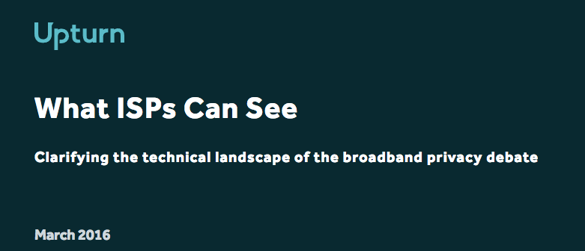
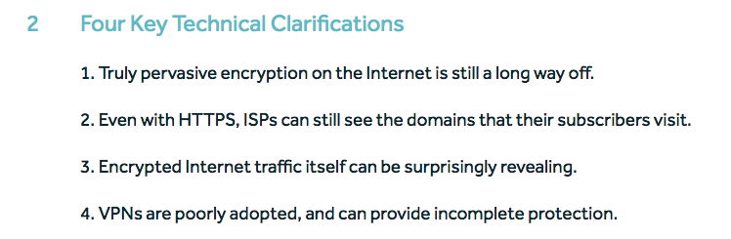
Notes:
Additional points: WebMD not using encryption, VPNs are difficult to use, …

Slide 57



April/May 2016: Flip Side of the Coin
Customer traffic is often used for security, research, innovation, etc.
These activities often involve sharing data with third parties (e.g., vendors, appliances, researchers)
Upshot: Preventing ISPs from sharing network traffic data (e.g., DNS traffic) could harm research!

Slide 58
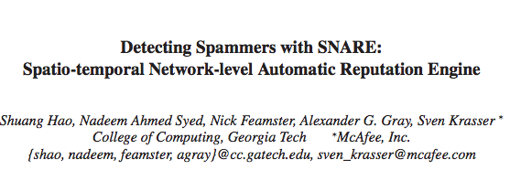
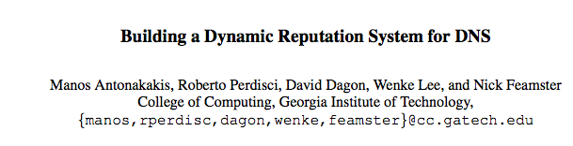
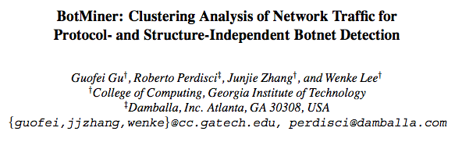
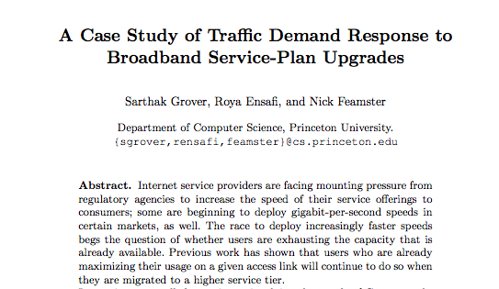
Examples of Research Using ISP Data

Slide 59
(Non-Exhaustive) Summary of Uses
Third-party security services
Research
Security
Network operations
Protocol and device innovation

Slide 60
Challenges
Striking the right balance between research and customer privacy protection
Creating exception language for researchers without opening the barn door for “researchers”

